Slide 1

BLACK FRIDAY SALES
BY: kirti ohlan

Slide 2
About
Black Friday sales dataset
By Retail Stores
550,000 observations
Contains:
Numerical Variables
Categorical Variables
Some missing values

Slide 3
Process
Dataset is provided by Flipo Robo.
Data Gathering
Exploring Data
Cleaning Data
Final Formatting of Data

Slide 4
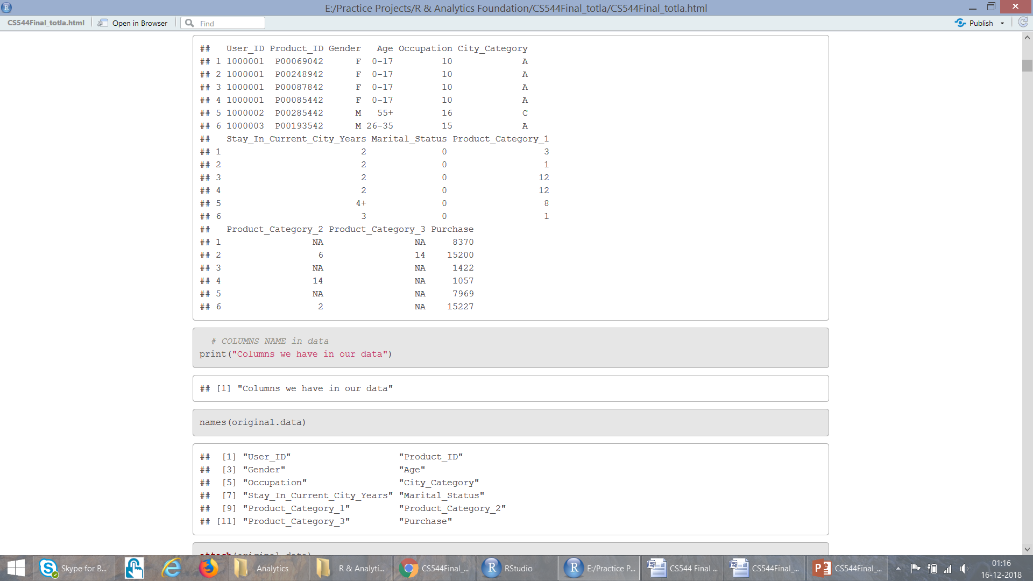
Attributes in Data
User_ID (Numerical Variable)
Product_ID (Categorical Variable)
Gender (Categorical Variable)
Age (Categorical Variable, because it is in ranges)
Occupation (Numerical Variable)
City_Category (Categorical Variable)
Stay_In_Current_City_Years (Numerical Variable)
Marital_Status (Numerical Variable)
Product_Category_1 (Numerical Variable)
Product_Category_2 (Numerical Variable)
Product_Category_3 (Numerical Variable)
Purchase amount in dollars (Numerical Variable)

Slide 5
Exploring Attributes
User Id: Not Unique, maps person to the particular purchase
Product Id: Not Unique, tells how many purchases are made for a product
Gender: Have only two variables: F M
Age: It is divided into 7 ranges, Here Age is Categorical Variable
Occupation: There are 21 different occupation ranging from 0-21
City Category: Cities in which customers have lived is categorized into three categories: A, B, C
Year.. : People have lived in the current city for 0-5 years. Here 5 could mean atleast 5 years
Marital Status: People have their marriage status marked as either 0 or 1
Product Category 1: Ranges form 1-18
Product Category 2: Ranges form 2-18
Product Category 3: Ranges form 3-18
Purchase: It is the amount people spent in $ for purchases. Not unique.

Slide 6
Analysis..

Slide 7
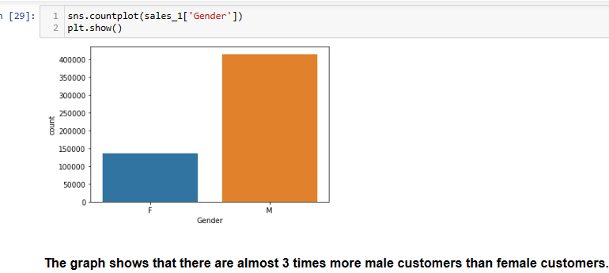
Analyse “Gender”

Slide 8
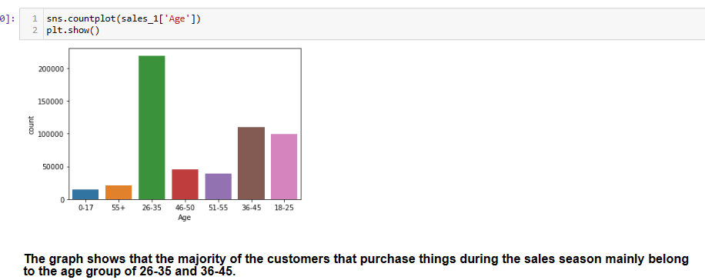
Analyse “Age-Range”

Slide 9
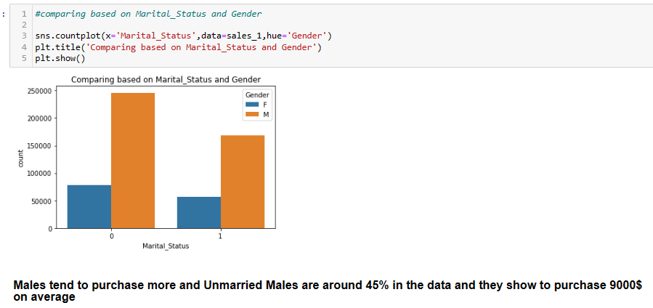
Comparing marital status and gender

Slide 10
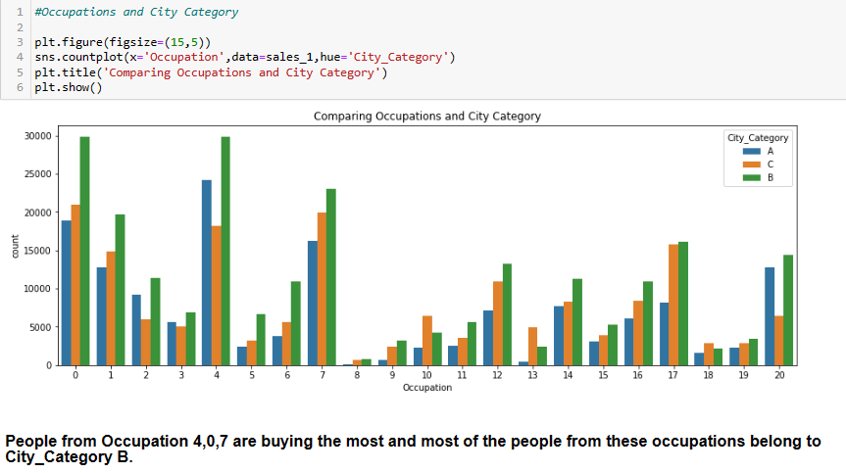
Comparing occupation and city category

Slide 11
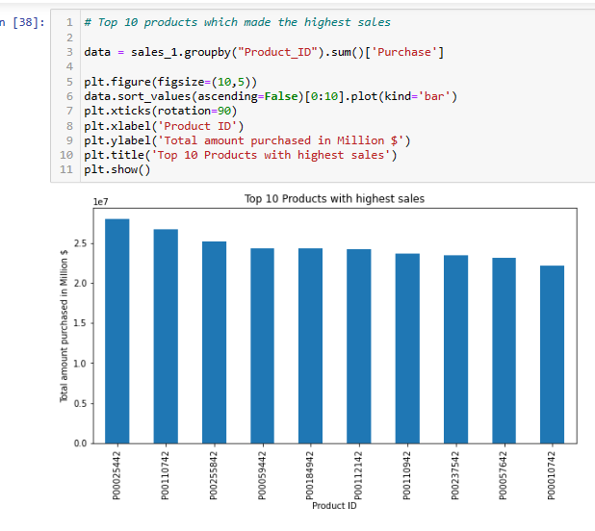
Top 10 products

Slide 12
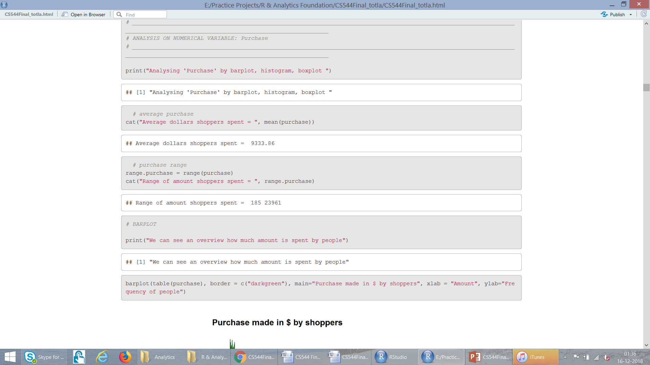
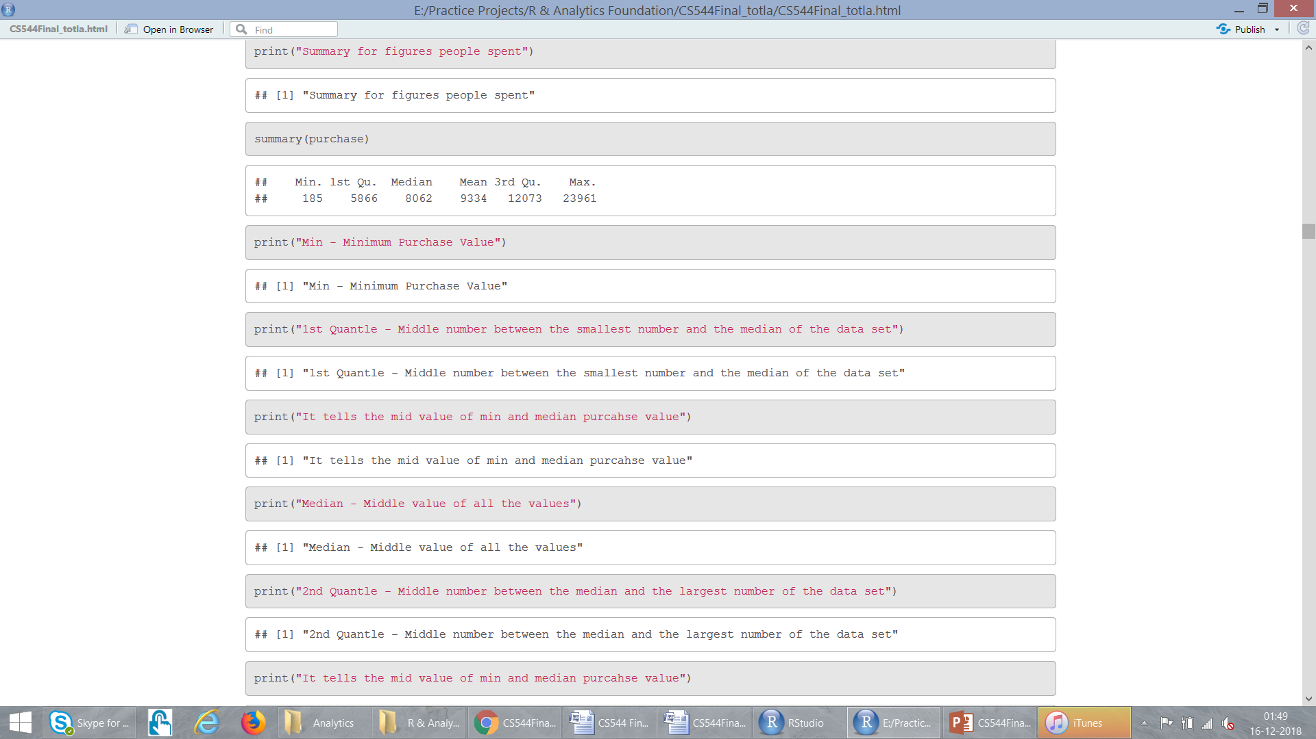
Analyse “Purchase”

Slide 13
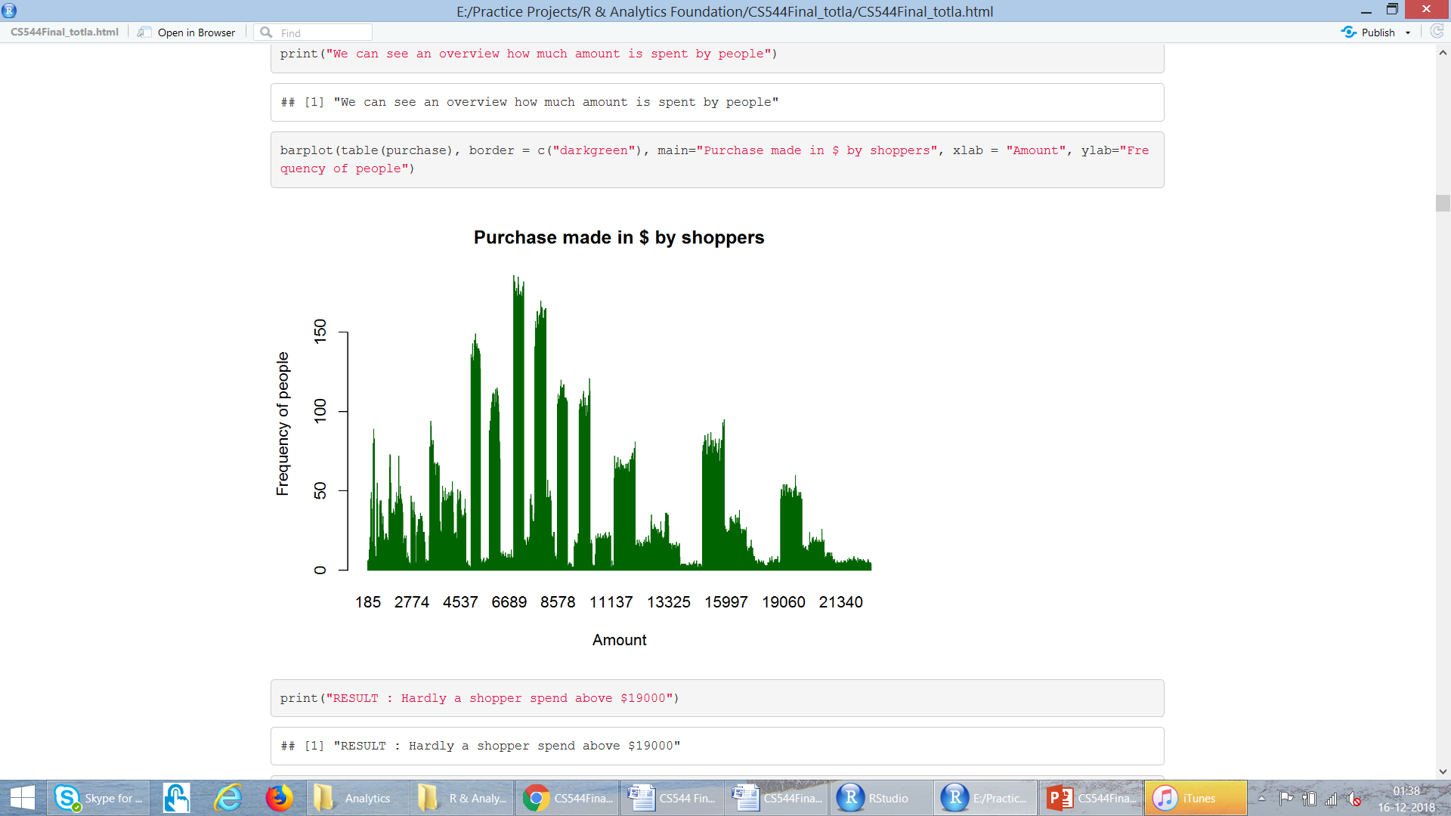
Analyse “Purchase” : Barplot

Slide 14
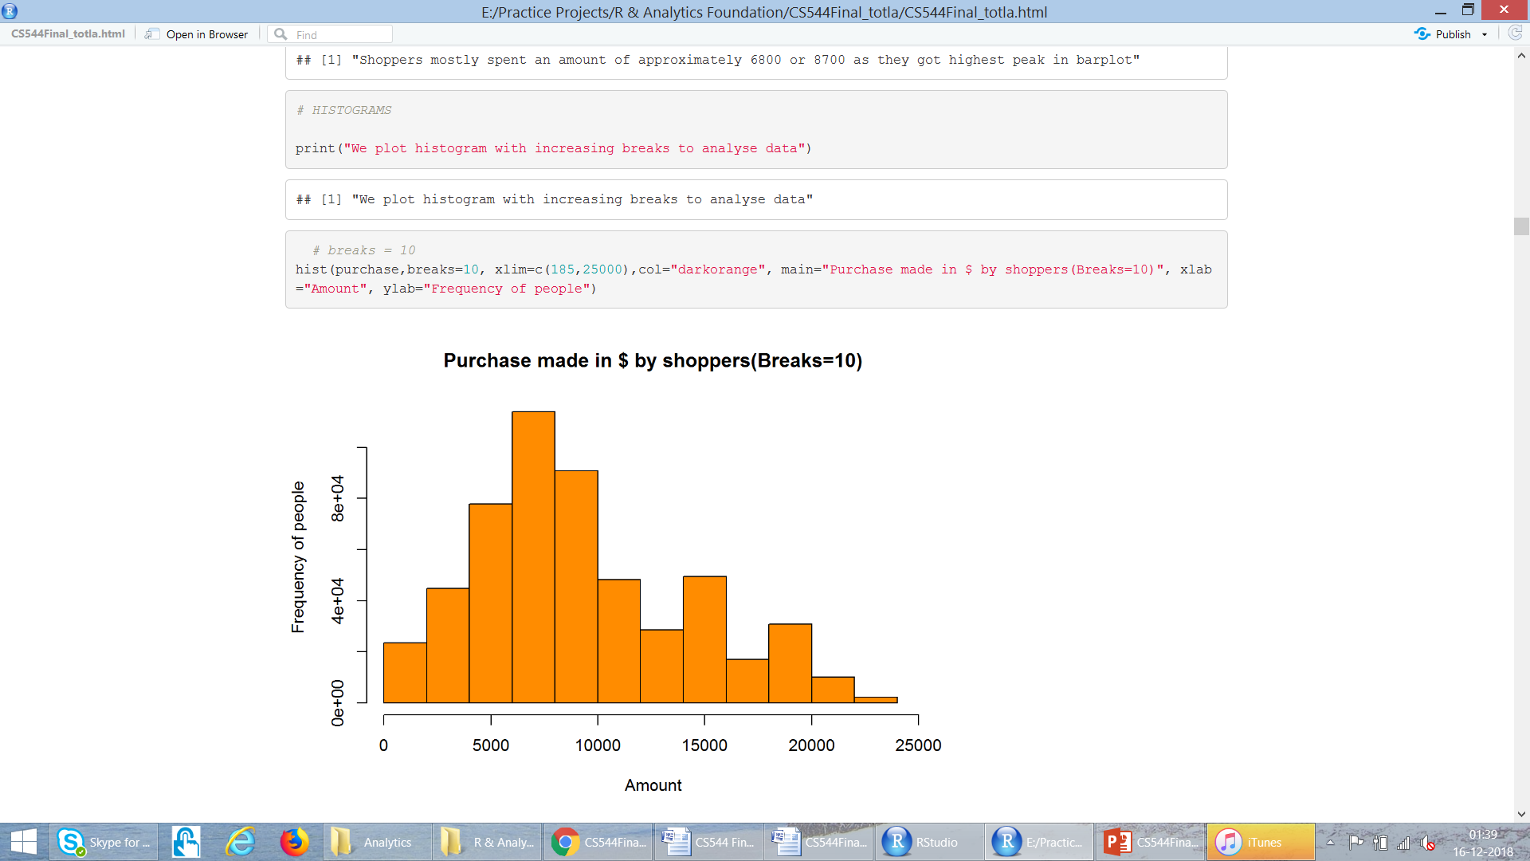
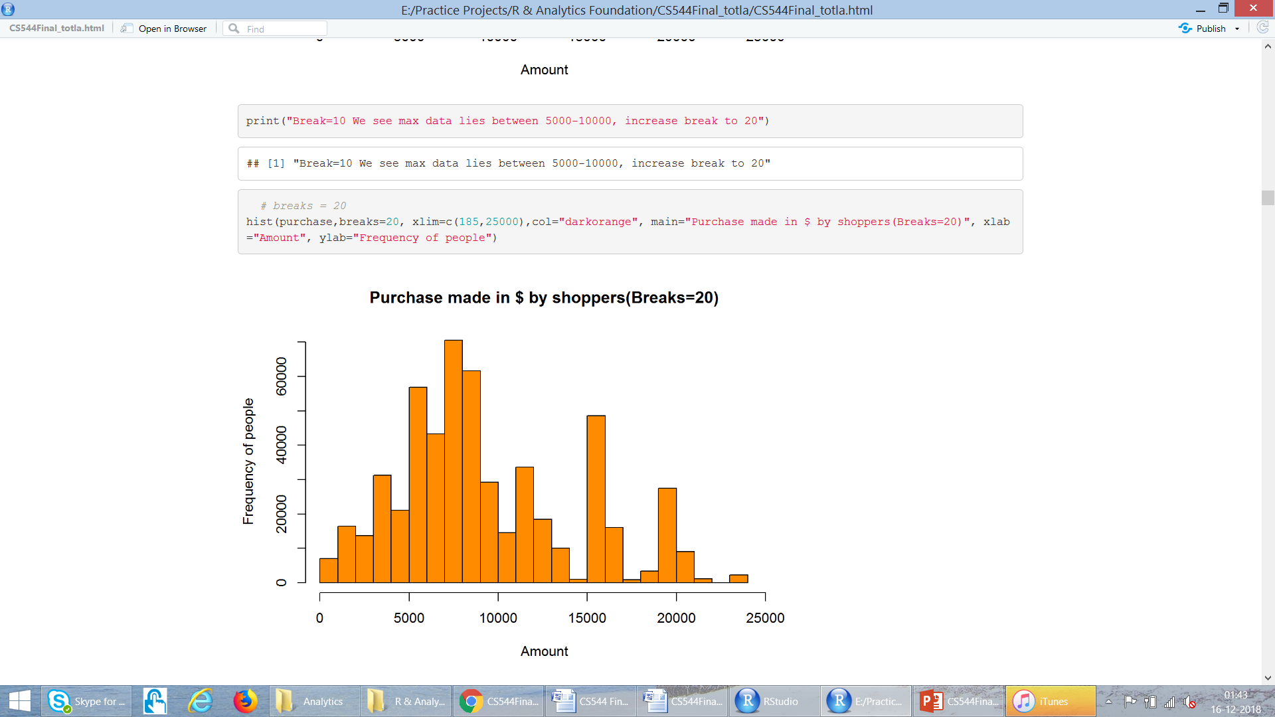
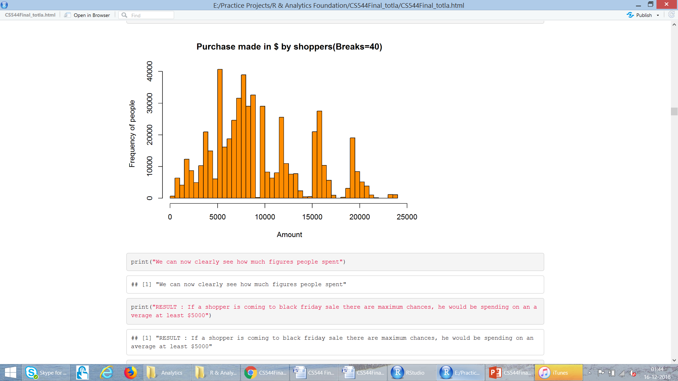
Analyse “Purchase” : Histograms

Slide 15
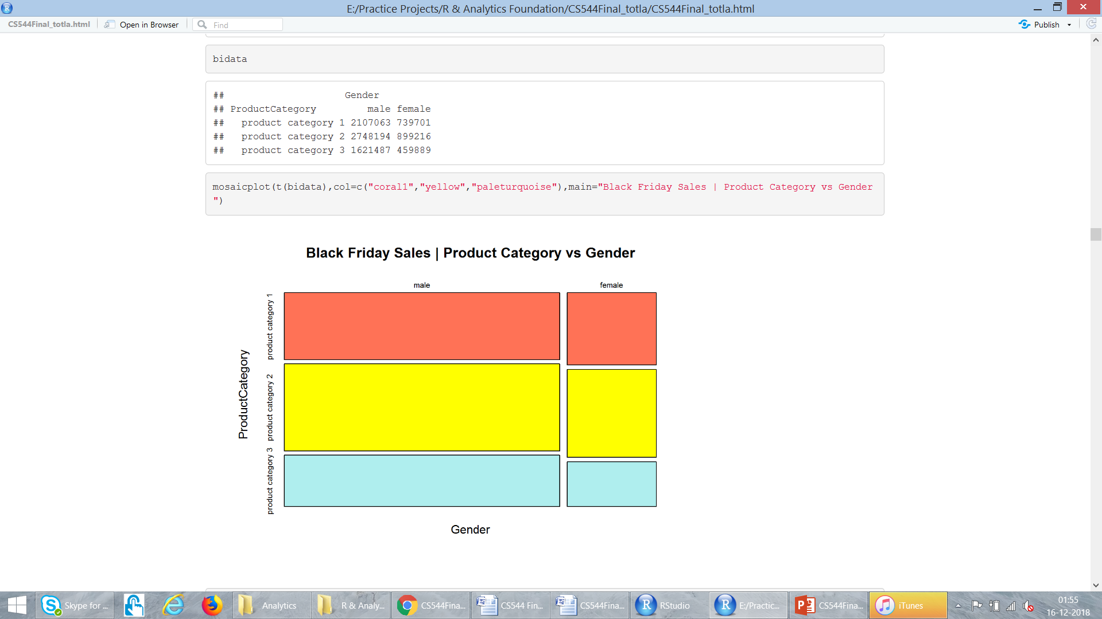
MULTIVARIATE DATA
Gender
Product Category 1
Product Category 2
Product Category 3

Slide 16
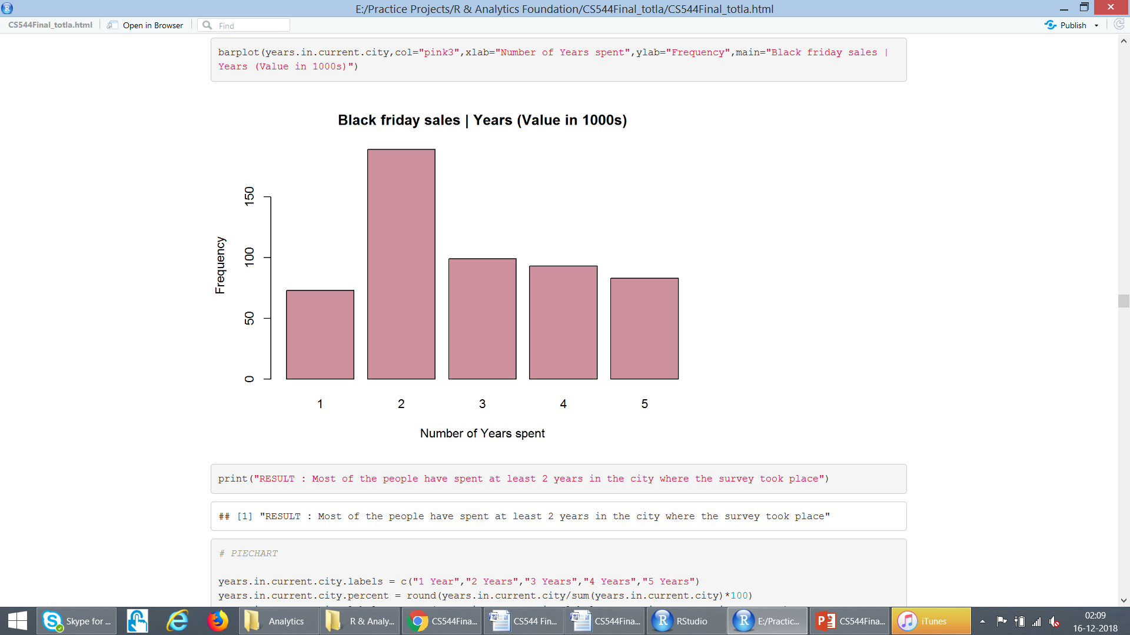
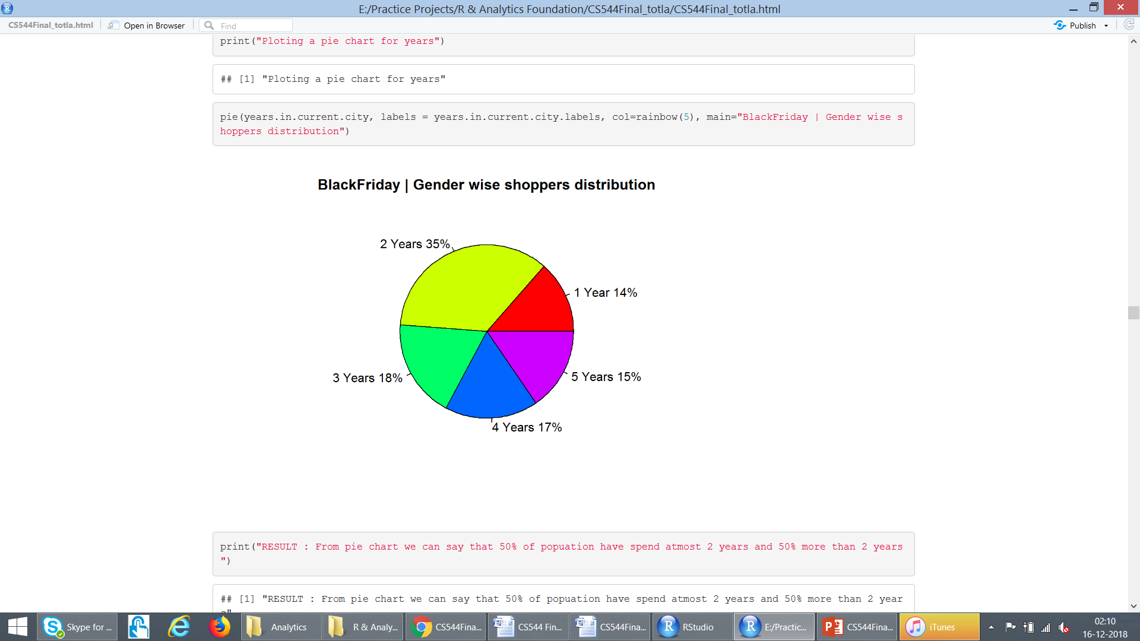
Analyse : “Years in Current City”

Slide 17
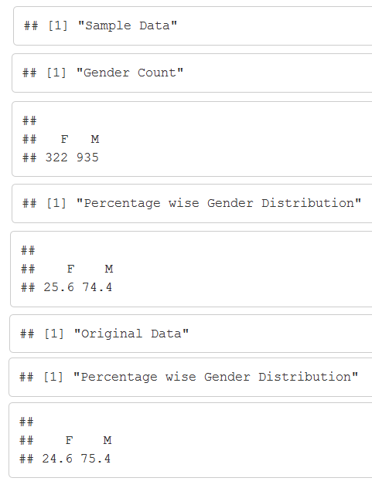
Simple Random Sampling : With Replacement

Slide 18
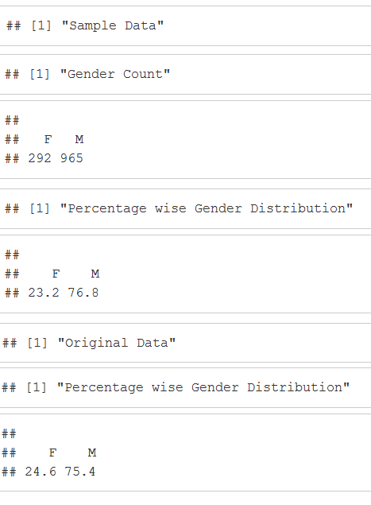
Simple Random Sampling : Without Replacement

Slide 19
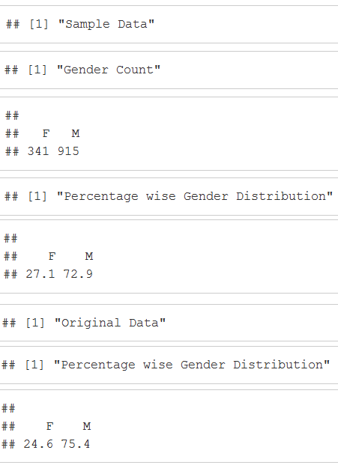
Systematic Sampling : Equal Probability

Slide 20
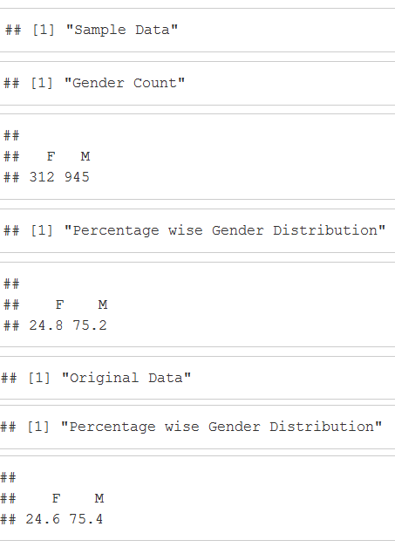
Systematic Sampling : Unequal Probability

Slide 21
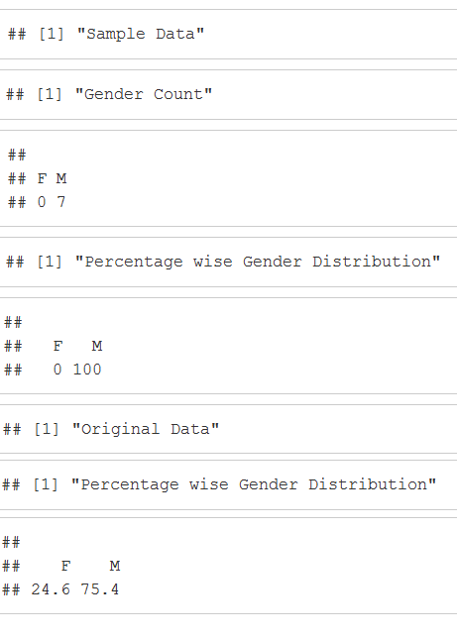
Stratified Sampling : Sample Size =10

Slide 22
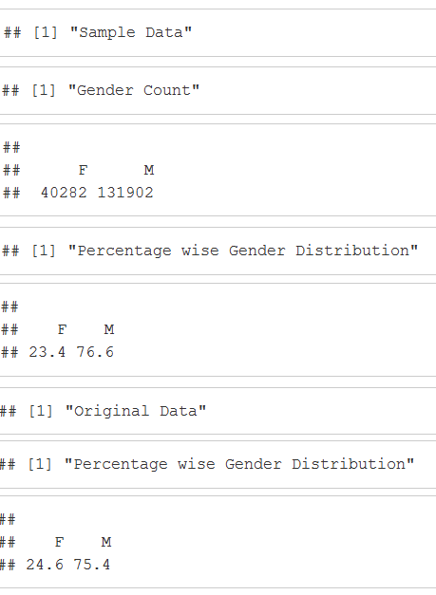
Cluster Sampling

Slide 23
Sampling
Therefore maximum change in original vs sample in:
Systematic Sampling : Equal Probability
Stratified Sampling : Sample Size =10
Almost similar interpretation
Systematic Sampling : Unequal Probability

Slide 24
Conclusion
Number of Male Shoppers > Female Shoppers
Products in Product Category 2 sold most
People generally spent over $5000 in sales
People in age range 26-35 purchase most
There are highest average sales in City Category ‘C’ as compared to other
Unequal Probability sampling technique could be used over this dataset for best results

Slide 25
Thank you!!

